Slide 1
Journey of Data in the Era of Spring

Slide 2
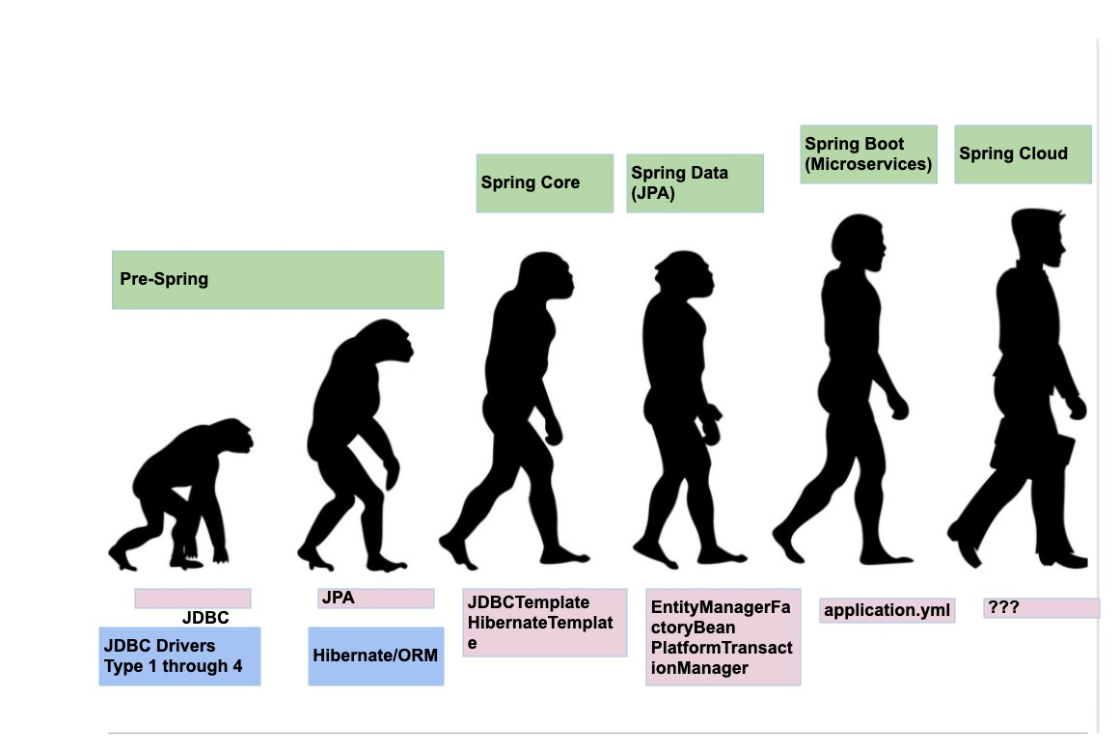
Spring Evolution

Slide 3
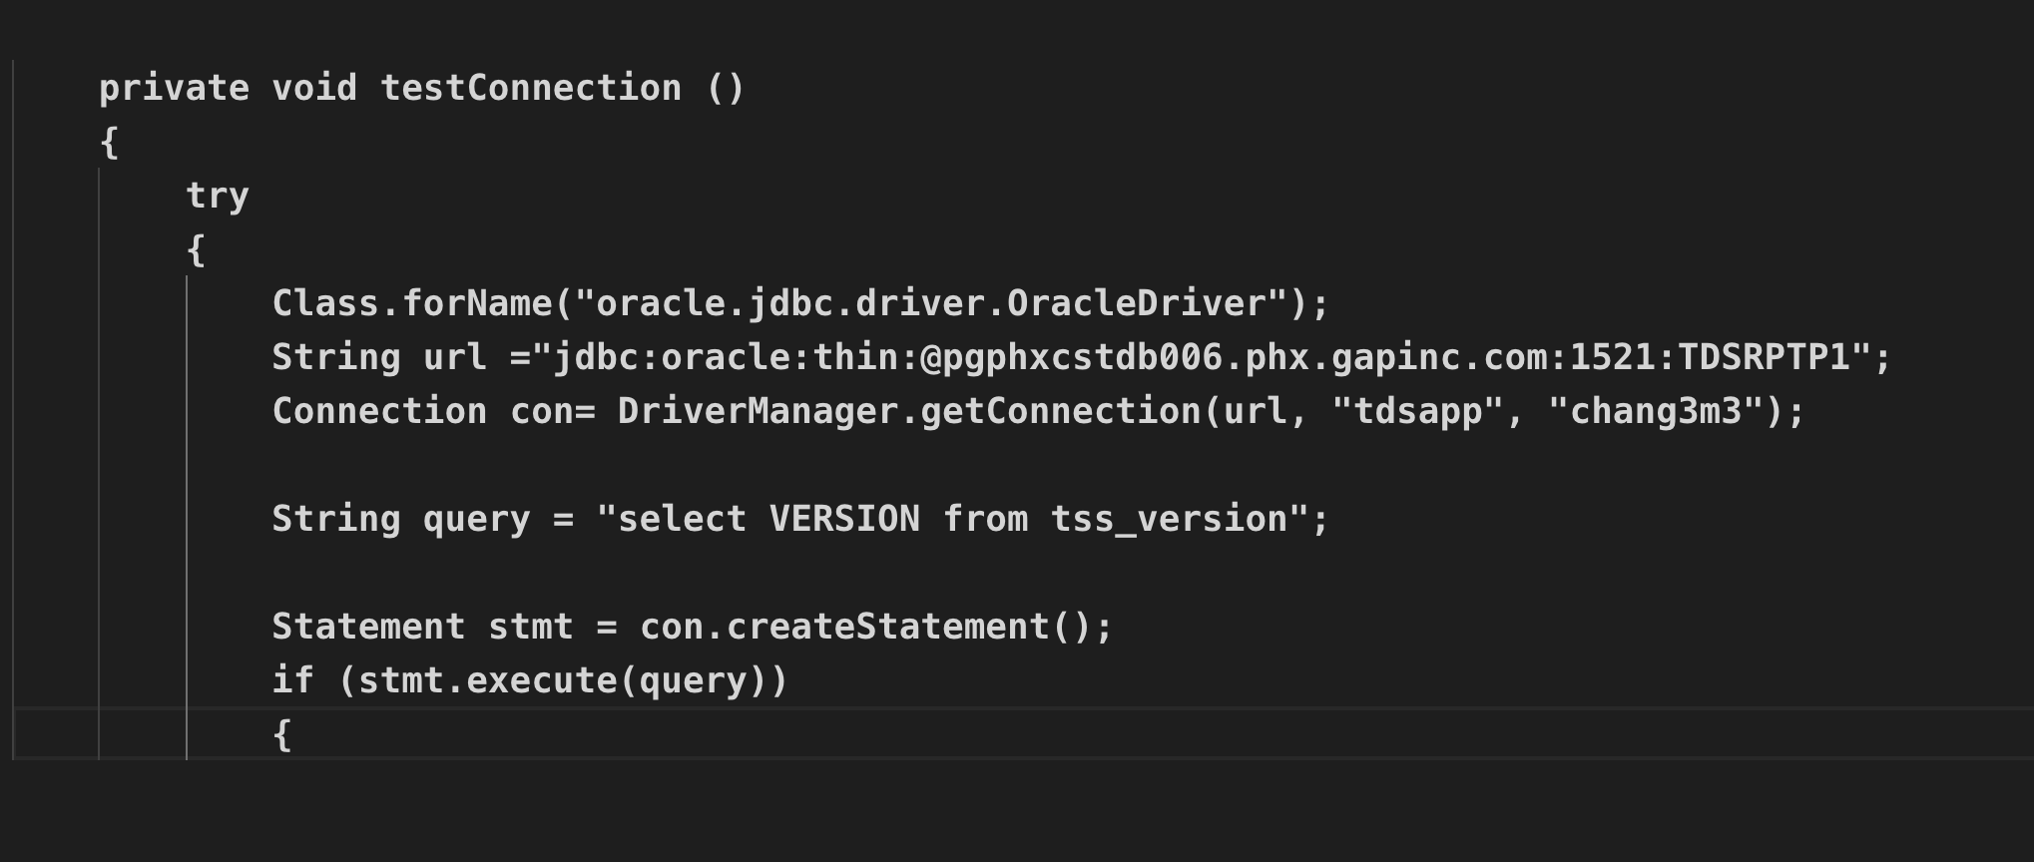
Pre-Spring ERA (JDBC)

Slide 4
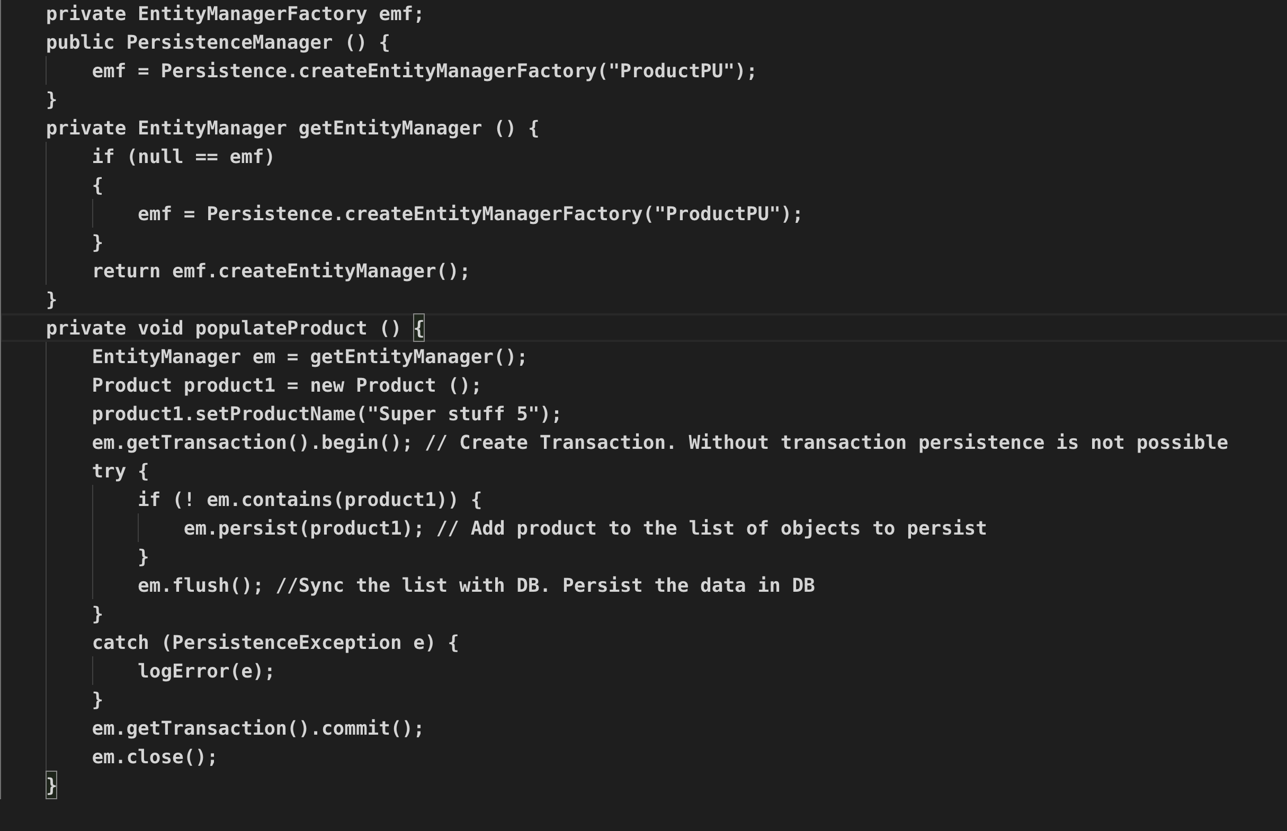
Pre-Spring ERA (JPA) - Hibernate

Slide 5
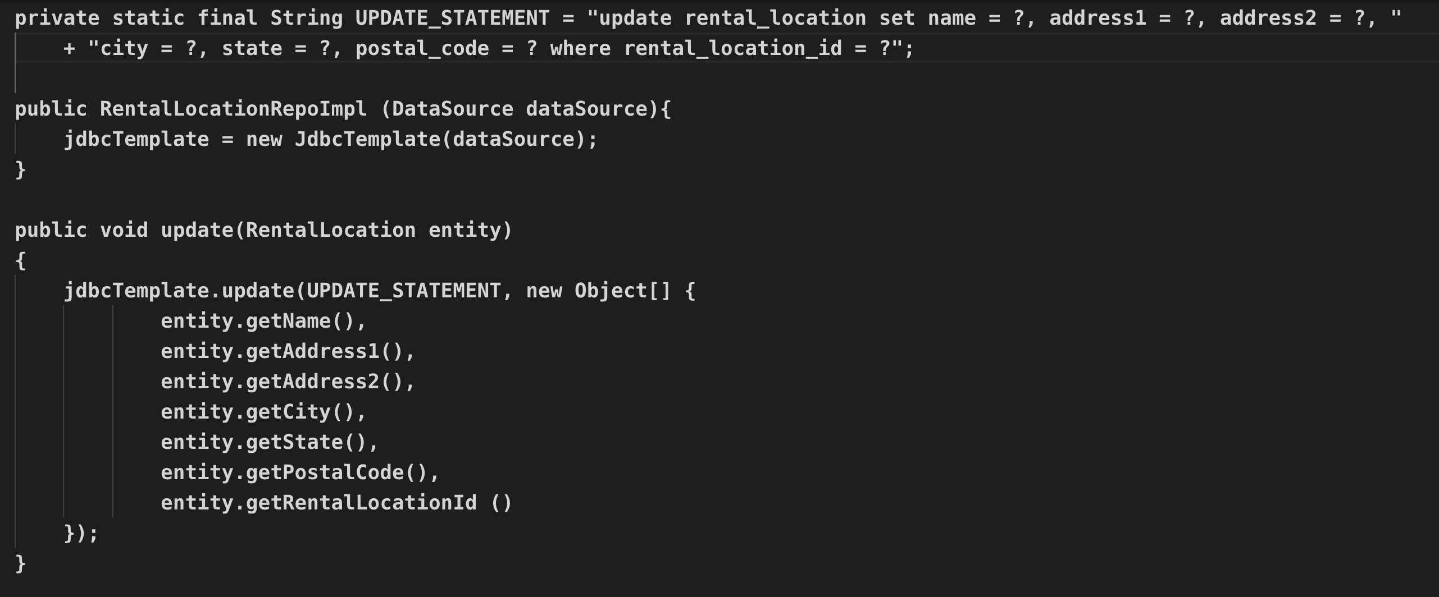
Spring Core - JDBCTemplate

Slide 6
Spring Data JPA
Demo Code

Slide 7
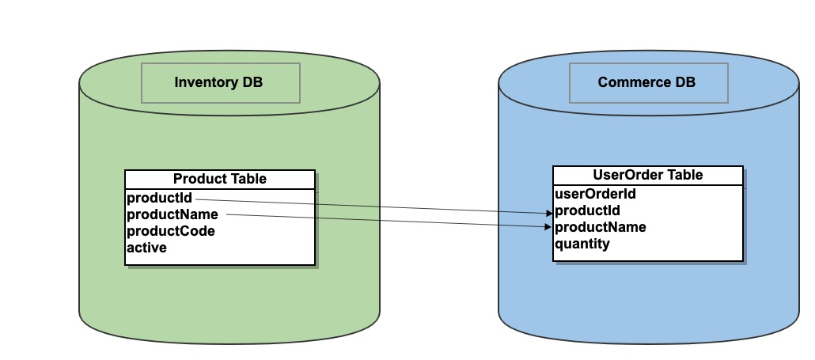
Spring Boot – Multi Database Access
Database Design

Slide 8
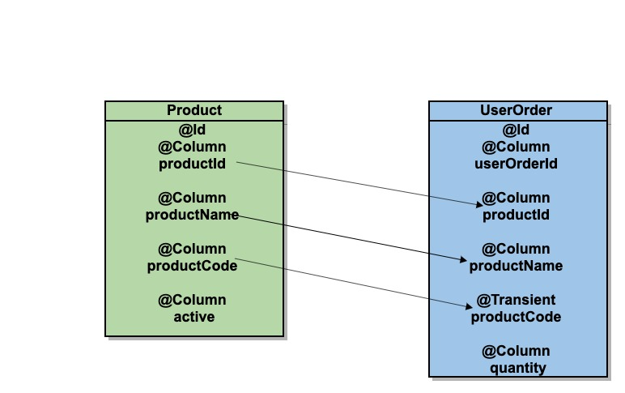
Spring Boot – Multi Database Access
Object Design

Slide 9
Spring Boot – Multi Database Access
Scenarios
Demo 2 Configuration Files –
CommerceDBConfiguration,
InventoryDBConfiguration
Product Data population – Show Code
Products features (Inserts into only One Schema - InventoryDB) – Add, Edit, Update, Delete – Show Code
Create an Order (Read from One Schema – InventoryDB and Write Data into another Schema - CommerceDB) – demo
getOrderById (Read data from two Schemas – CommerceDB + InventoryDB to return a complete Object ) – demo
getAllOrdersForAProduct (Read data from two Schemas – CommerceDB + InventoryDB to return an aggregate of multiple Objects) - demo

Slide 10
Github repo - https://github.com/rekharokkam/demo-multi-schemas
References
https://www.baeldung.com/spring-data-jpa-multiple-databases
https://springframework.guru/how-to-configure-multiple-data-sources-in-a-spring-boot-application/

